Slide 1




Flood Patterns in East Coast Catchments: How have they changed?
Emily Speckman, Kelin Whipple
Arizona State University
April 19, 2025
Arizona Space Grant Consortium Statewide Symposium

Slide 2
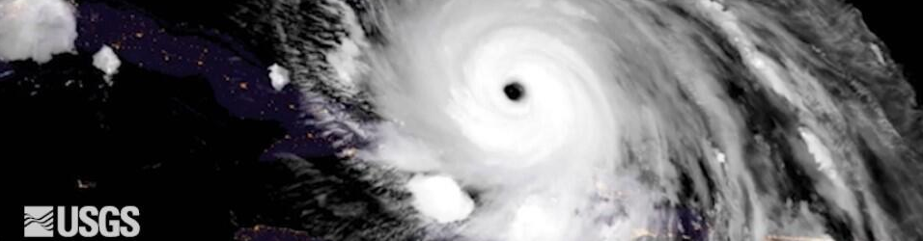
Background & Objectives
North Carolina experienced devastating floods in September 2024 from Hurricane Helene
Hurricanes have been getting stronger
Has this changed the flood record?

Slide 3
Methods
Gauges II & 2009 Hydro-Climatic Data Network
ArcGIS Pro
Keeping area and average relief, in consistent ranges
FEMA Hurricane Risk Zones

Slide 4
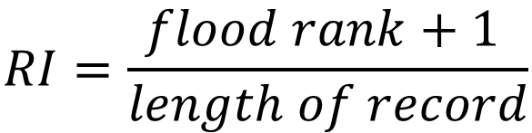
Methods
USGS Flood Data:
Use of yearly peak discharge to form a recurrence interval plot
Discharge normalized to drainage area
$$RI=\frac{flood rank+1 }{length of record}$$

Slide 5
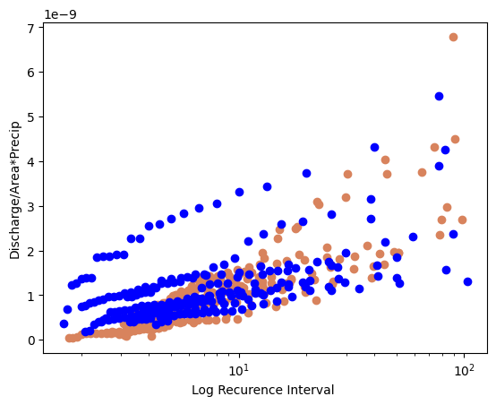
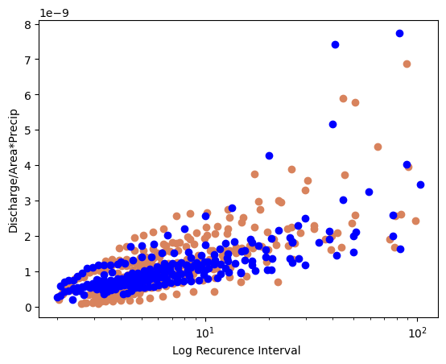
Results
Orange is inside hurricane zone
Blue is outside hurricane zone
Pre-2000
Post 2000

Slide 6
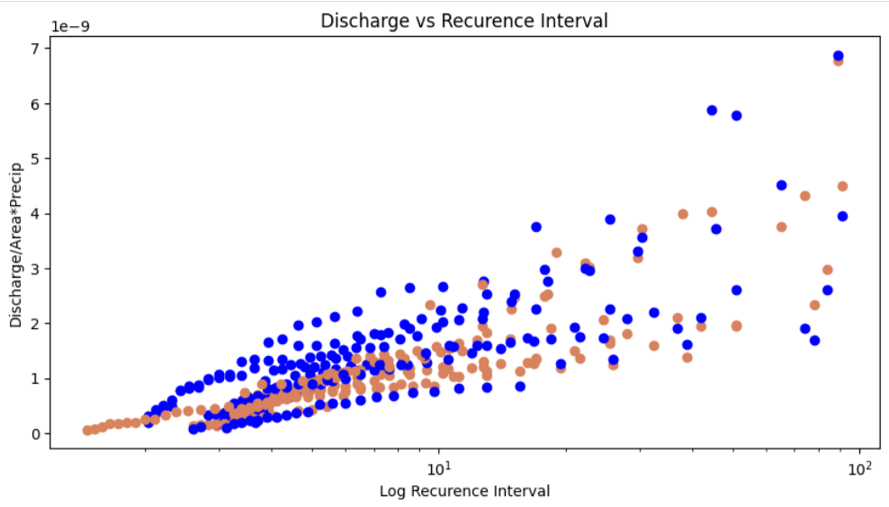
Results
Recurrence Interval vs. Normalized Discharge
Orange is pre-2000
Blue is post-2000

Slide 7
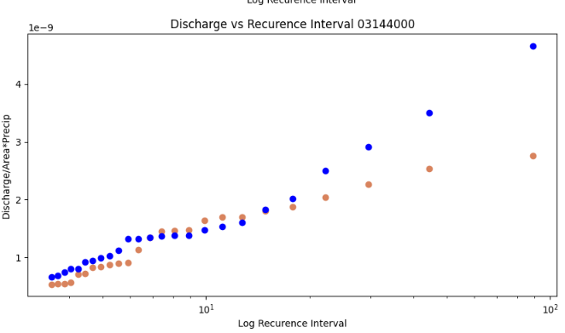
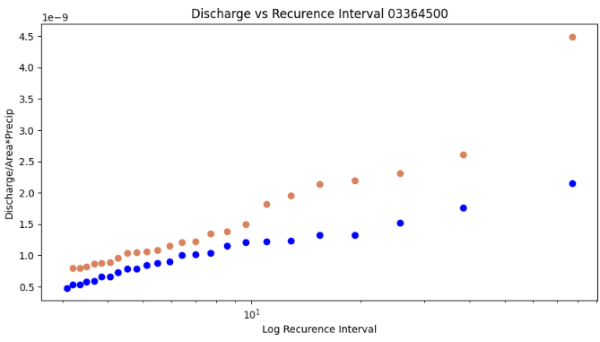
Results cont…
Sample of catchments outside hurricane zone:
Orange is pre-2000
Blue is post-2000

Slide 8
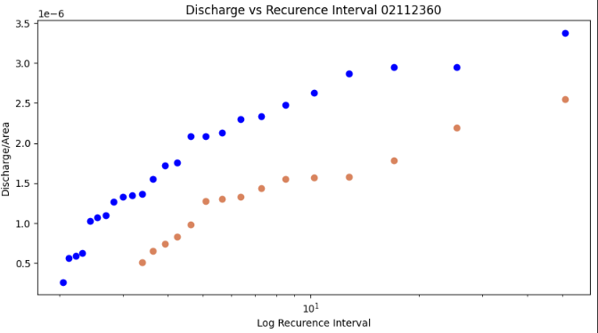
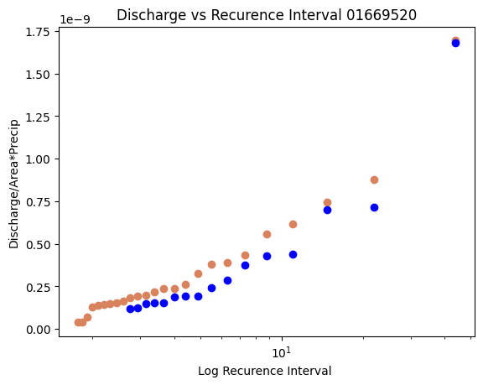
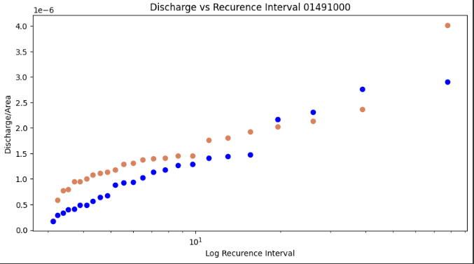
Results cont…
Sample of catchments inside hurricane zone:
Orange is pre-2000
Blue is post-2000

Slide 9
Acknowledgements
Kelin Whipple, Professor, Arizona State University
Arizona NASA Space Grant
NSF Grant: Collaborative Research: Climatic Control of Erosion Rates and Landscape Morphology - Quantifying the Influence of Fluvial Thresholds (EAR-2229222)
Arizona State University & School of Earth and Space Exploration
This presentation template was created by Slidesgo, and includes icons by Flaticon, and inforgraphics & images by Freepik

Slide 10
Thank You!

